Slide 1
Processes Lesson 2 Interprocess Communications
David Liu
Fall 2021, Spring 2022

Slide 2
Why Do Processes Communicate?
Information sharing
Computation speedup
Modular system design

Slide 3
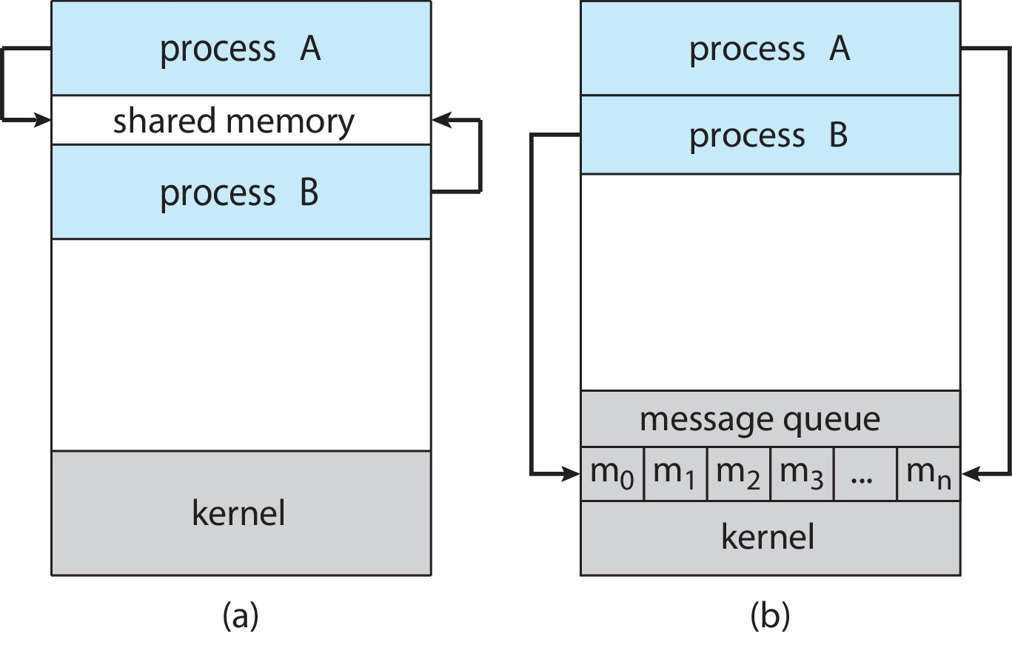
How do Processes Communicate
Shared memory
Message passing
(a) Shared memory. (b) Message passing.

Slide 4
Shared Memory or Message Passing
Implementation
speed

Slide 5
Shared Memory
Who creates a region of shared memory?
How do processes to synchronize their access of the memory
Read and write

Slide 6
Shared Memory Example
A producer and A Consumer with a bounder-buffer
#define BUFFER_SIZE 10
typedef struct {
. . .
} item;
item buffer[BUFFER_SIZE];
int in = 0;
int out = 0;

Slide 7
Producer & Consumer Process
Producer Process
Consumer Process
item next_produced;
while (true) {
/* produce an item in next_produced */
while (((in + 1) % BUFFER_SIZE) == out)
; /* do nothing */
buffer[in] = next_produced;
in = (in + 1) % BUFFER_SIZE;
}
item next_consumed;
while (true) { while (in == out)
; /* do nothing */ next_consumed = buffer[out];
out = (out + 1) % BUFFER_SIZE;
/* consume the item in next_consumed */
}

Slide 8
Producer & Consumer Process
Correct (Effective)?
Efficient?
Only 9 buffers are used.
How to improve?

Slide 9
Message Passing
Operations
Send(message)
Receive(message)
Message size?
Logical Link?

Slide 10
Message Passing Logical Link Design
Direct or indirect communication
Synchronous or asynchronous communication
Automatic or explicit buffering

Slide 11
Direct Communication
Explicitly specify (name) other process
send (P, message), receive(Q, message)
One and only one link between only two processes

Slide 12
Indirect Communication
A shared mailbox or port
Send(A, message), receive(A, message) (A is a mailbox ID)
More two processes can share a mailbox
Question: who is going to receive a message?

Slide 13
Indirect Communication
A shared mailbox or port
Send(A, message), receive(A, message) (A is a mailbox ID)
A mailbox can be owned by a process or the OS

Slide 14
Message Passing Synchronization
Sender | Receiver | Example
blocking | blocking | rendezvous
blocking | nonblocking
nonblocking | blocking
nonblocking | nonblocking

Slide 15
Buffering
Queue of messages
Zero capacity
Bounded
unbounded

